Slide 1


Coding the Collection:
Sprint 4 Demo
Team: Will Ye, Edward Zhuang, Sam Chan, Santo Grillo
Clients: Julia McHugh, Mark Olson

Slide 2
Demo
Sam: Back button to pages, tiles fully clickable, sanitization/restrictions of inputs, edit artwork/delete artwork functionality, backend modifications and improvements
Santo: Presentation Page Modifications
Eddie: Implement user-specific projects, create landing page, create shareable projects
Will: adding contextual media to artwork, adding more fields to artwork, code cleanup
Notes:
Santo

Slide 3
Value
We wanted to focus on extended functionality that met our clients’ next priority needs (after basic functionality was implemented)
Most important:
Collaboration between users (sharing of projects)
Contextual images and descriptions
Increased User Experience and navigation between pages
Sanitization of inputs, presentation of projects
Notes:
Sam: why did we decide to work on various things, not just what

Slide 4
User Testing Results
Positive
All tasks were accomplished by our testers with only minor complications
“My colleagues are some of the least technologically knowledgeable people I know” - Julia McHugh
Critical
Made some assumptions about what would be “intuitive” to the user
Full name in registration fields
Tiles not fully clickable
Notes:
“Generally straightforward”
We purposely made the application simple to users, as our target demographic are curators who may not be tech savvy.
Thought it would be “intuitive” to the user,
Prefilled input says “full name”. Every single person put in their first name, put last name in email, etc.
Switched it so its first name, then last name. Made some changes so registration process would be more familiar to user.

Slide 5
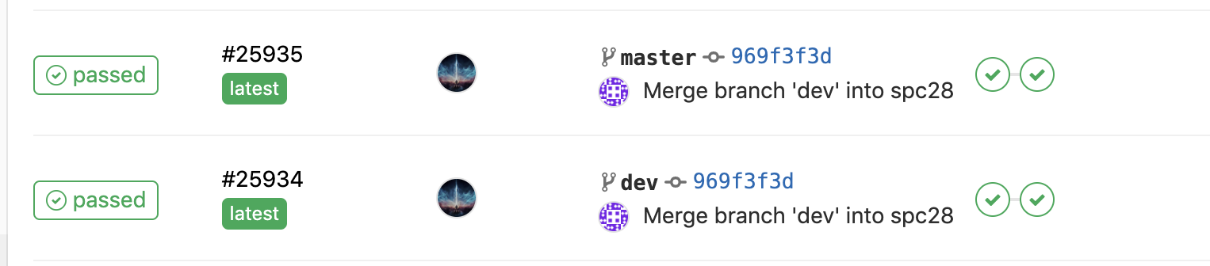
Testing Results
Manual testing: go through entire creation lifecycle
Limited Unit Test Coverage (will improve for next sprint)
Automated test now successful
Tests run on merge

Slide 6
Design Justification
Front-end framework: React vs. Flask
Back-end framework: Firebase vs. SQL
Method of application deployment: VCM vs. Heroku
Styling: Nasher
Type of Application: Web App vs. Mobile App
Type of User Authentication: Email/Password vs. Other Providers
Notes:
Sam
https://coursework.cs.duke.edu/compsci408_2019fall/app_codingthecollection/wikis/Design-Justification
Describe one design choice to make easily changeable for the client and your justification for that choice (including alternatives)
Choice: Sign in on via email and password
Justification: Our justification for signing on via email and password was that we wanted to build a minimal viable product that still preserved basic functionality of allowing users (curators) to store their particular projects as well as state and identity.
Alternatives: Google sign in, Facebook sign in, Shibboleth (Duke)
Trade-Offs: Some of the other options, notably Shibboleth, are more familiar to the users. This is a stretch goal for the project, however since it requires significantly more development and set up than the simple email sign-up, we elected to push this type of authentication to a later sprint, since our discussions with the client revealed that having a basic functional product was preferred.

Slide 7
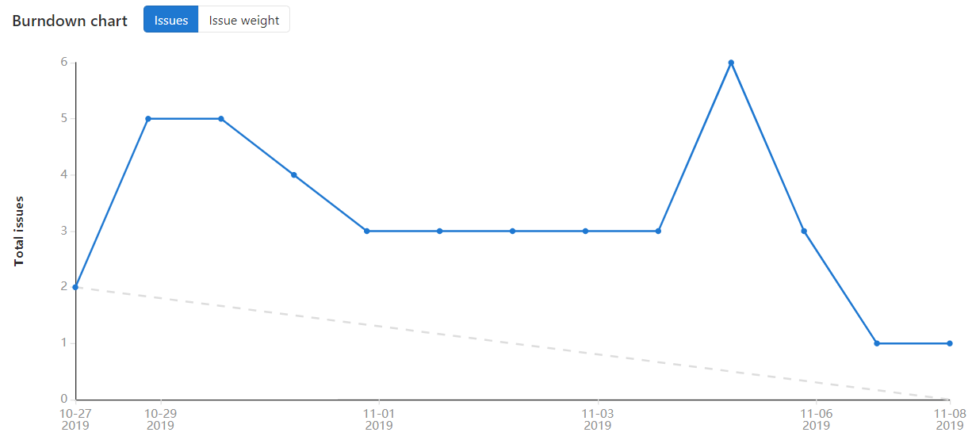
Burndown Chart

Slide 8
Timeline
Week 1
User-specific projects
"Dev" branch
Week 2
Shared projects
Updated new artwork/edit artwork pages
Contextual images/descriptions
Bug fixes + UX Improvements

Slide 9
Retrospective
What worked:
Proactivity among team members
What did not work:
Not enough communication
One thing to improve:
Improve communication by implementing online standups
Change to Team Contract:
Designated a member of team to be routine deadline checker
Notes:
Proactivity among team members - our team was most effective when everyone was driven to accomplish their tasks.
Not enough communication still - didn’t always know what teammates were working on or what needed to be done.
One concrete thing we wish to improve is our communication. After our retrospective and taking note of what other groups have done, we have implemented standups online every monday wednesday and friday. We will measure improvement by checking to see that everyone is responding to these standups.
To stay on top of things, we designated a member of team to be routine deadline checker.

Slide 10
Planning Next Sprint (Sprint 5)
Polish core functionality
Optimize and clean code
Beautify website
Create more robust tests

Slide 11
Thanks for Listening!

